Slide 1

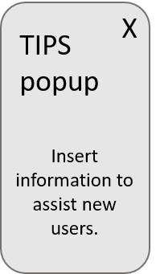
LOGO
Degree Works + Networking
Home | About | Contact | Login
Networking Opportunities
Based on your degree path and listed career interests
Table Header | Table Header | Table Header | Table Header
Person_1 | Company_1 | Position_1 | 1email@email.com
Person_2 | Company_2 | Position_2 | 2email@email.com
Person_3 | Company_3 | Position_3 | 3email@email.com
Person_4 | Company_4 | Position_4 | 4email@email.com
Networking Events
Table Header | Table Header | Table Header
Location_1 | Date / Time | Sign Up
Location_2 | Date / Time | Sign Up
Location_3 | Date / Time | Sign Up
? Help | FAQ

